Slide 1

Introduction to Data Science/Machine Learning
University of Wisconsin Milwaukee
Fall 2025
Sammie Omranian

Slide 2

Girls Who Code – Week 6
Describing Data with Statistics
🧠 How numbers help us describe and compare data!
We’ll learn:
Mean, Median, Mode
Correlation (how two things move together)
Hands-on coding practice

Slide 3

Agenda
Today’s Plan:
What are mean, median, and mode?
Why they matter in data science
Correlation – when two variables are connected
Hands-on: Spotify datasets
Reflection
🕒 We’ll learn → code → see results → share discoveries!

Slide 4
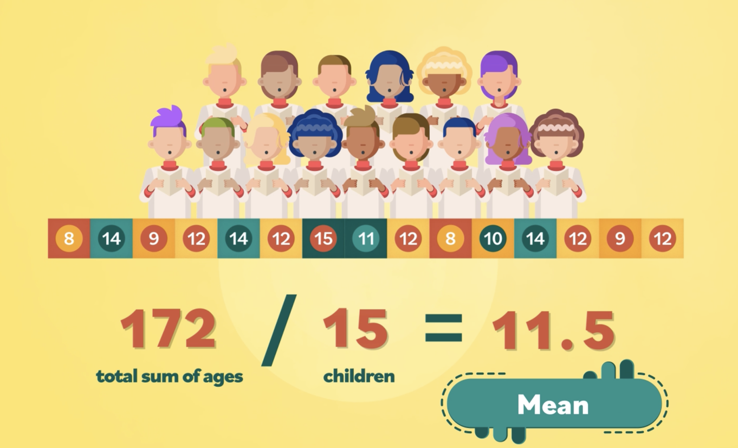
What is Statistics?
🎲 “Statistics” sounds like a big word… but it’s really just learning from data! 🎯
Image credit

Slide 5
Statistics
Example:
Imagine everyone in the class shares how many minutes they spend on TikTok:
Some spend 10 mins, some 200 mins 😱
Instead of reading all the numbers, we can describe the whole group with:
Average (mean) – about how much everyone spends
Middle value (median) – what’s typical
Most common (mode) – what most people do
🧠 That’s statistics! Turning many numbers into a simple story.

Slide 6
Why Describe Data?
📊 Data visualization shows us the picture,
📈 but statistics help us summarize that picture with numbers.
Example:
If we have the ages of 100 passengers…
Do we really want to look at all 100? No! We can describe them with a few values → mean, median, mode.

Slide 7
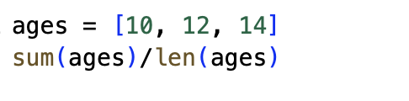
Mean (Average)
💡 The mean is the average — add them up, divide by how many.
Example: 10, 12, 14
→ (10 + 12 + 14) / 3 = 12
🧩 Try in Python:

Slide 8
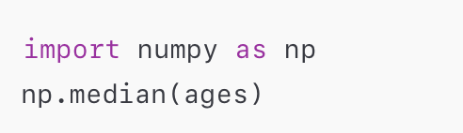
Median (Middle Value)
📍 The median is the middle number when sorted.
If there’s an even number, take the average of the two middle ones.
Example: 10, 12, 14, 18 → median = (12 + 14)/2 = 13
🧩 Try in Python:

Slide 9
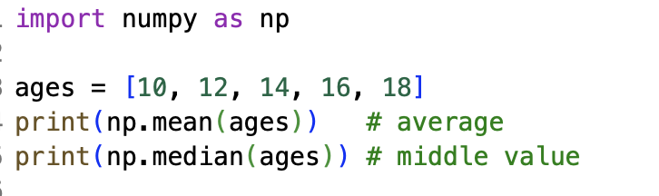
What is NumPy
💡 NumPy (pronounced Num-Pie) stands for Numerical Python
It helps Python do math with lists of numbers more easily.
Think of it as a math helper for your data! 🧮
🧩 Try in Python:

Slide 10
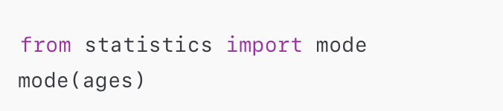
Mode
🎯 The mode is the number that appears most often.
Example: [10, 12, 12, 14] → mode = 12
Think of it as a math helper for your data! 🧮
🧩 Try in Python:

Slide 11
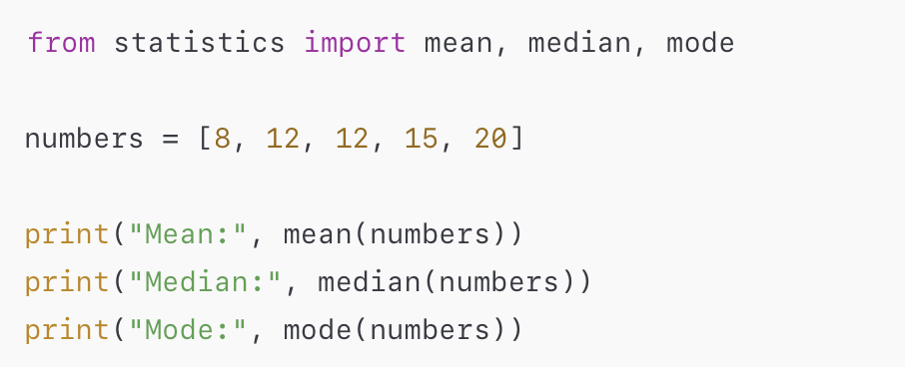
What the statistics Module?
📊 Python has a built-in helper for data called statistics
You don’t need to install anything — it’s already included!
It helps us quickly find things like:
Mean → average
Median → middle value
Mode → most common value
🧩 Try in Python:

Slide 12
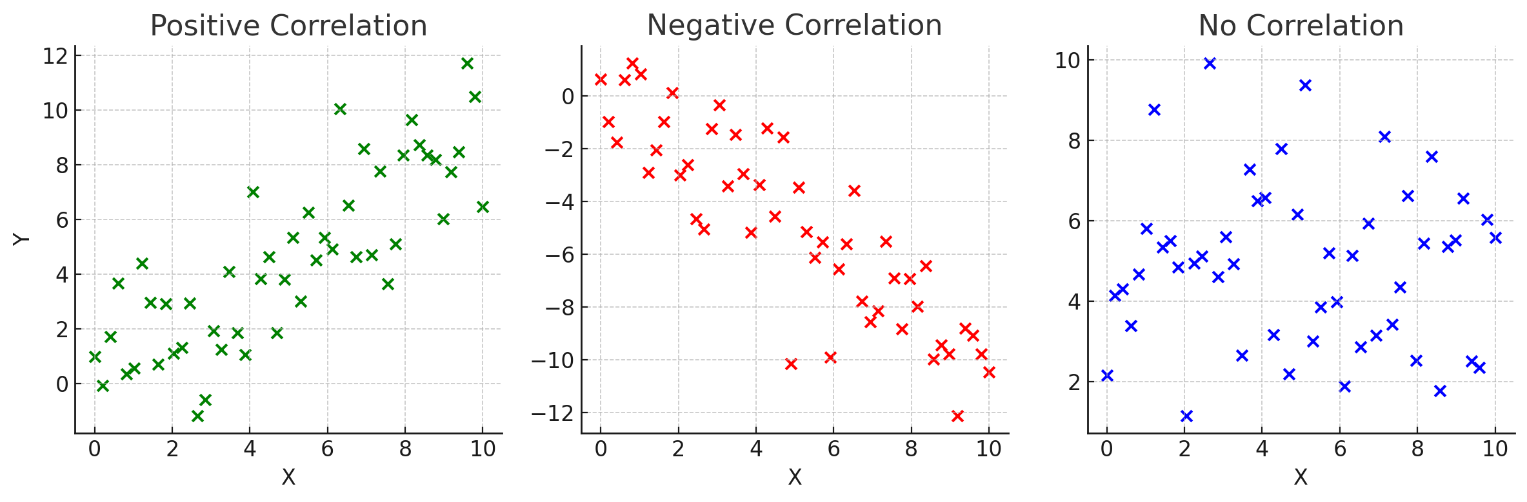
Understanding Correlation
📈 Correlation = how two things move together.
Positive correlation: when one increases, the other increases (📱 usage & battery drain).
Negative correlation: when one increases, the other decreases (🌡️ temp & coat sales).
No correlation: no pattern at all.
🧠 It’s not cause-and-effect, it’s just a relationship.

Slide 13
Understanding Correlation
📈 Correlation = how two things move together.
Positive correlation: when one increases, the other increases (📱 usage & battery drain).
Negative correlation: when one increases, the other decreases (🌡️ temp & coat sales).
No correlation: no pattern at all.
🧠 It’s not cause-and-effect, it’s just a relationship.
🧩 Try in Python:

Slide 14
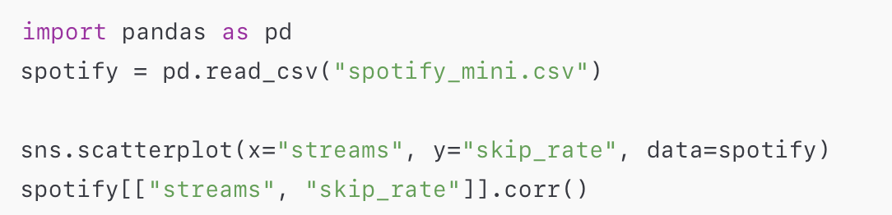
Correlation - Practice
📈 Using spotify_mini.csv 🎵
🧩 Try in Python:

Slide 15

Google Colab – Our Coding Hub Where we’ll write, run, and share all our Python code

